Slide 1

ALGORITHMS FOR INTELLIGENCE WEB & INFORMATION RETRIEVAL
What’s In It For You ?
Dr. Nagegowda K S
Department of Computer Science Engineering

Slide 2

ALGORITHMS FOR INTELLIGENCE WEB & INFORMATION RETRIEVAL
What’s In It For You ?
Dr. Nagegowda K S
Department of Computer Science Engineering

Slide 3
ALGORITHMS FOR INTELLIGENT WEB & INFORMATION RETRIEVAL
Course Objective
Understand the architecture, models and algorithms used in Information Retrieval.
Understand the basic principles and implementation of Indexing and Search.
Understand the use of machine learning in Information Retrieval and Web Applications.
Understand the recommendation algorithms and Clustering Algorithms and their working.
Understand the different web Applications

Slide 4
ALGORITHMS FOR INTELLIGENT WEB & INFORMATION RETRIEVAL
Course Outcome
Implement an efficient index for a document collection.
Perform searches on a document collection, rank and evaluate results.
Apply Machine Learning techniques in Information Retrieval Systems and Web Applications.
Implement different recommendation algorithms and clustering algorithms.
Design different intelligent web applications.

Slide 5
ALGORITHMS FOR INTELLIGENT WEB & INFORMATION RETRIEVAL
Clearing the Subjects Confusion !
Machine Learning and Deep Learning (ML/DL): ML and DL are about methods of function approximation(not applications).
Natural Language Processing (NLP) : Deals with algorithms specifically for text data. The key NLP model is “sequence model” and current state of art NLP models are deep learning based (image net moment of NLP arrived in 2018).
Information Retrieval (IR) : extracting information from text data (ML + DL on text) and optionally do a search on the text corpus (Classical and web SEARCH) .
Intelligence Web: The intelligent web, also often referred to as Web 3.0, involves the idea that World Wide Web pages, sites and applications will continue to be imbued with artificial intelligence

Slide 6
ALGORITHMS FOR INTELLIGENT WEB & INFORMATION RETRIEVAL
What Strategy Are you Following For Choosing Electives ?
All of these are good strategies as long as you have a plan in mind !
Focus on Systems And Core Computing
Focus on becoming a Coding Geek, Advanced Algorithms
Focus on Security in Internet Age
Focus on (Big Data + ML+ AI + Data Science) because it is the information age
Some special subjects that you find appealing
Information Retrieval fits here !!

Slide 7

ALGORITHMS FOR INTELLIGENT WEB & INFORMATION RETRIEVAL
Scope of this Subject !
Machine Learning for text
Unit 5
Search
Engine
Layer 3
Natural Language Processing
Index Classical IR
Unit 1-3
Index
Web IR
Unit 4
Layer 2
Machine Learning
Deep Learning
Layer 1
Text (Big) Data

Slide 8

ALGORITHMS FOR INTELLIGENT WEB & INFORMATION RETRIEVAL
How does this course Help Position Your Resume ?
Parallel computing, HPCA, Reconfigurable Computing, Storage, Wireless Network
etc.
Information Security, Network Security,
Block Chain
etc.
CSPA, HCI, ERP, Design Patterns, Generic Programming etc.
Natural Language Processing, Information Retrieval.
Image Processing, Pattern recognition, Computer Vision etc.
Deep Learning
Text Data
Image/Video Data
Computer architecture, Automata Theory, Compiler Design, DBMS, Operating System, Web Technology, Data Structure, Algorithm, Computer Networking, OOAD and OOP, Big Data , Cloud computing, Machine Learning, Language skills (C++, Python, Java etc.) etc.
Notes:
Who have aligned themselves with Data Science specialization
Machine learning methods get applied on different domains of big data i.e. text , video, image, speech. One has to choose a domain to get specialized (not Jack of all trades..)
Already comfortable and interested about text data ( taken NLP course or done ML/DL based assignments on text )
Want to utilize this course for reinforcing their grip and competence around text data by acquiring insights and building meaningful course projects
Your course project can either focus on search or ML/DL based specific text IR application
Interested in search on physical as well as web corpus

Slide 9
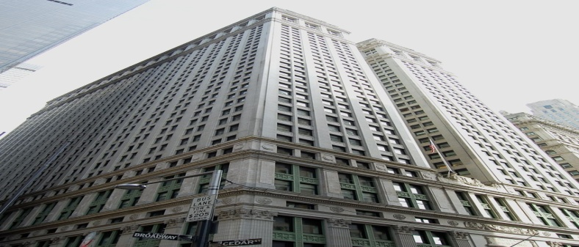
ALGORITHMS FOR INTELLIGENT WEB & INFORMATION RETRIEVAL
Who Hires For This Skill Set ?
Companies using social media data to get business insights.
Example - Voice Of Customer, Lead Generation, Financial Trading, Audience engineering !
Companies using corporate text based applications .
Example – Legal Document analysis, Warranty analysis, Customer Service Applications
Big daddys like Microsoft, Google, Amazon as they deal with Billions of pages of text every day !

Slide 10
ALGORITHMS FOR INTELLIGENT WEB & INFORMATION RETRIEVAL
Is it Good For Future Research Career / Higher Study ?
In most universities , IR and NLP are in the same school.
Stanford University -Incubated two most successful IR companies i.e. Google and Yahoo!
Prof Christopher Manning now runs the CS224n: Natural Language Processing with Deep Learning @ Stanford and also runs CS 276 / LING 286: Information Retrieval and Web Search
Look at ACM SIGIR and find out which US research schools are publishing in IR !
University of Massachusetts Amherst , Carnegie Mellon University
University of Maryland, University of Illinois at Urbana-Champaign
Purdue University, University of Washington
Rutgers University, Northeastern University
And many others …
A popular trend now is Information Retrieval in different domains

Slide 11
ALGORITHMS FOR INTELLIGENT WEB & INFORMATION RETRIEVAL
Course Structure and Evaluation
Details have to be still decided (everything depends on enrolment and interest )
What we can expect
ISA with assignments
ESA with course project
What can be course project areas where you need to code
Any interesting IR problem using text data (most welcome to use cutting edge NLP techniques)
Hard to do any search project with so less amount of data. So, course projects in this are not expected but one can try Apache Nutch/Solr APIs by his own initiative (but what is the benefit ? )

Slide 12
THANK YOU
Dr. Nagegowda K S
Department of Computer Science Engineering

